Slide 1
Police Feedback System
By Ketan Kedar and Milan Sharma

Slide 2
INTRODUCTION
Our Police Feedback System makes it easier for the public to share their experiences without any worries. It is a web site which is easy to use and navigate, and it also lets the users keep their identities hidden while providing their valuable feedback.

Slide 3
FEATURES
Bulk-SMS System
Full Feedback page
Interactive Chatbot
Uses session management as security
Feedback Analysis for Admins
Supports multiple languages (Hindi and English)

Slide 4
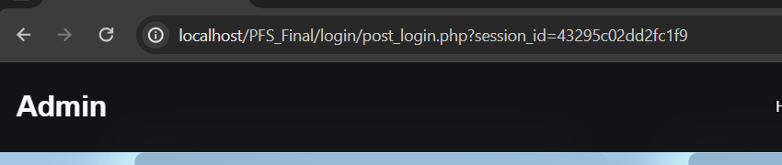
Security aspects
Our website uses session management as the main aspect to security.
Attacks like broken web authentication, SQL injections, Unauthorized Access, parameter tempering, Insecure Direct Object References, etc. are mitigated in our website.
It uses a unique session id each time a user logs in which only lasts till the user reloads or logs out

Slide 5
Multilingual
Our Website supports both Hindi and English languages.
It allows seamless transition between English and Hindi which lets wide range of people to provide feedbacks.

Slide 6
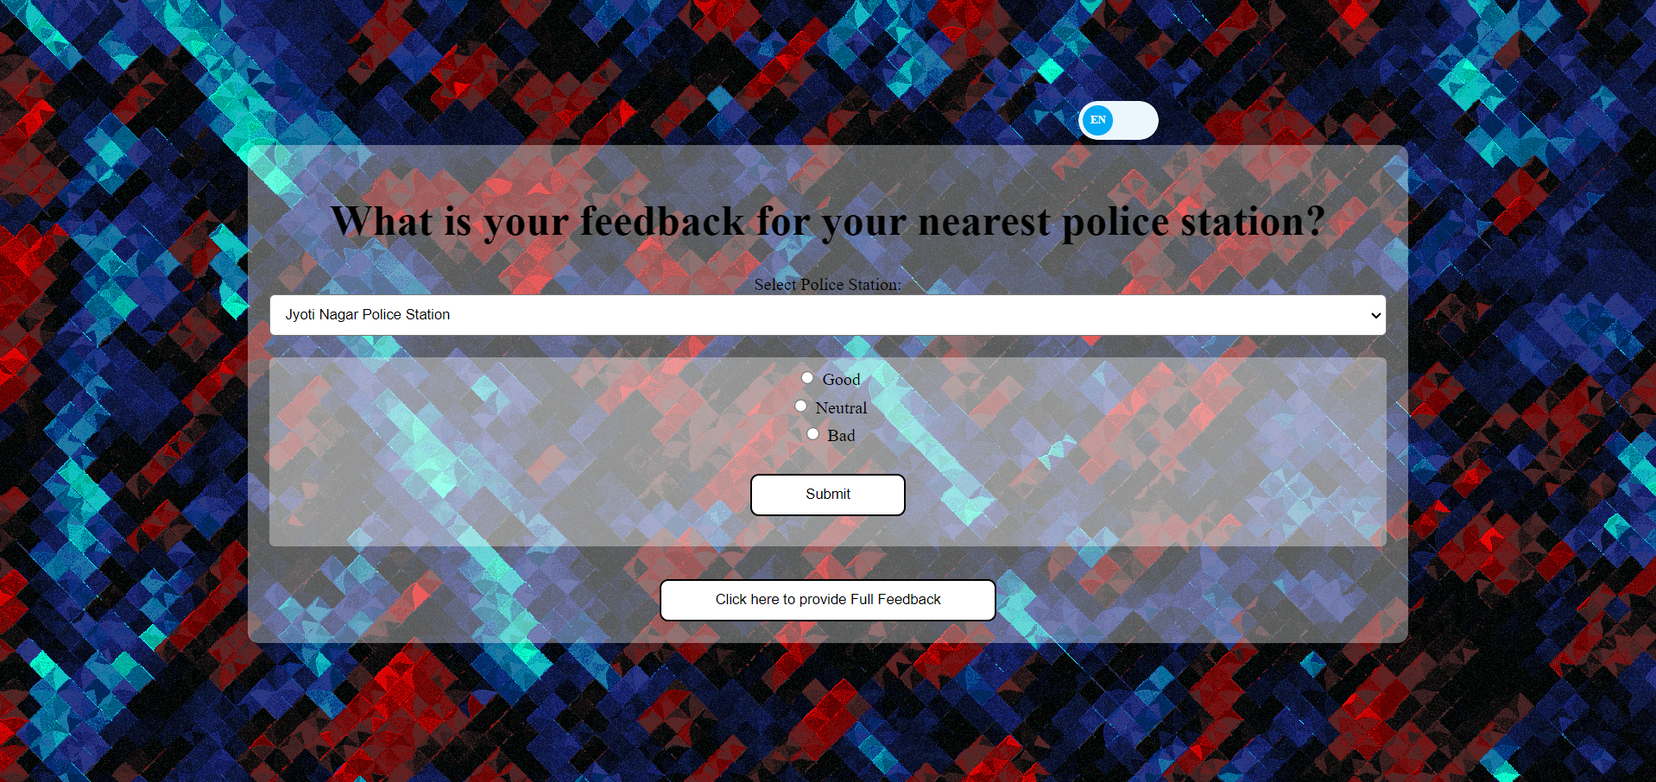
Bulk-SMS System
The Bulk SMS system uses twilio python library to send messages.
It shares link to the feedback page where users are asked to provide short, good neutral or bad feedbacks

Slide 7
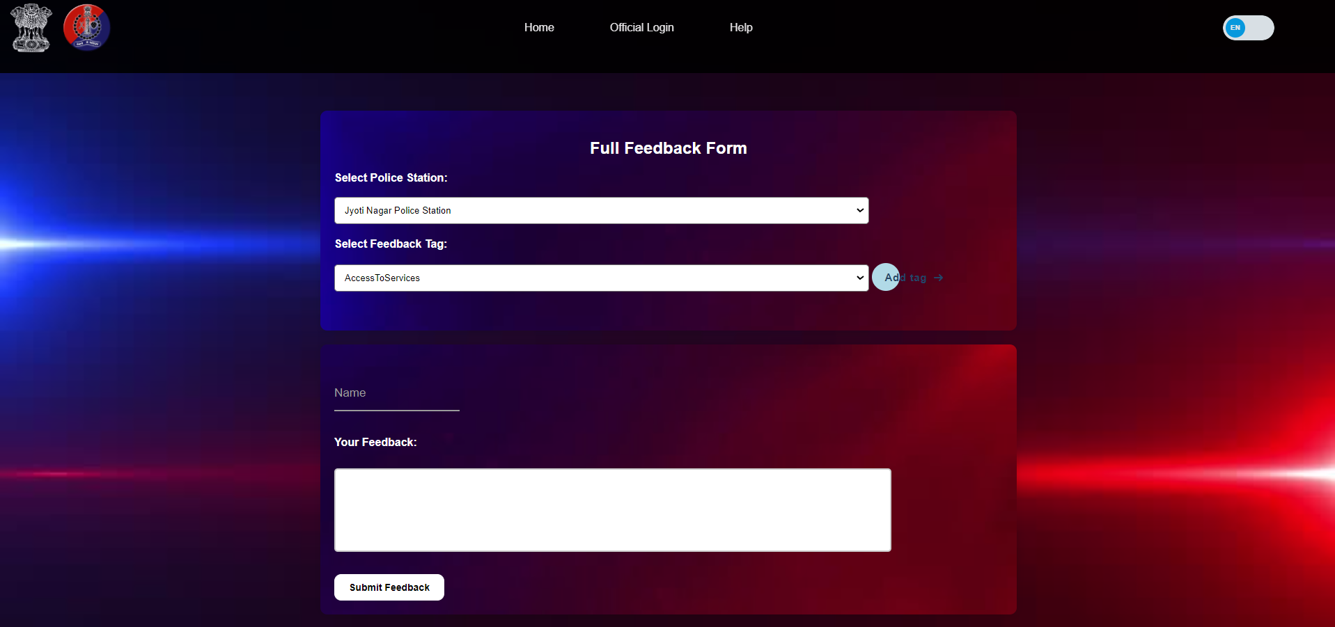
Full Feedback
Our full feedback page lets user give their feedback in full description.
It lets them select a police station they wish to provide feedback on.
It uses a tagging system which lets users choose their relevant tags for better describing their feedback.
User can choose to provide their names, by default it is anonymous.

Slide 8
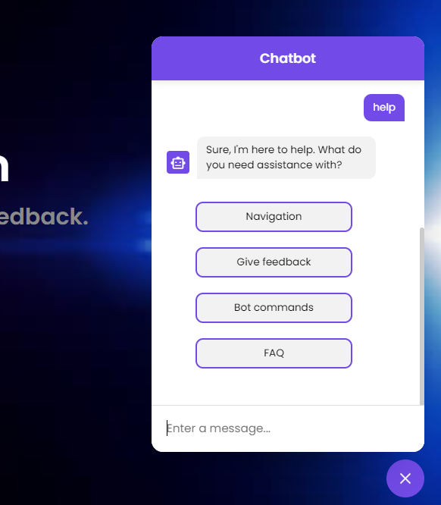
Chatbot
Our Chat bot can help users with various tasks such as navigating the webpages, support options etc.
It reads user inputs to generate predefined responses.

Slide 9
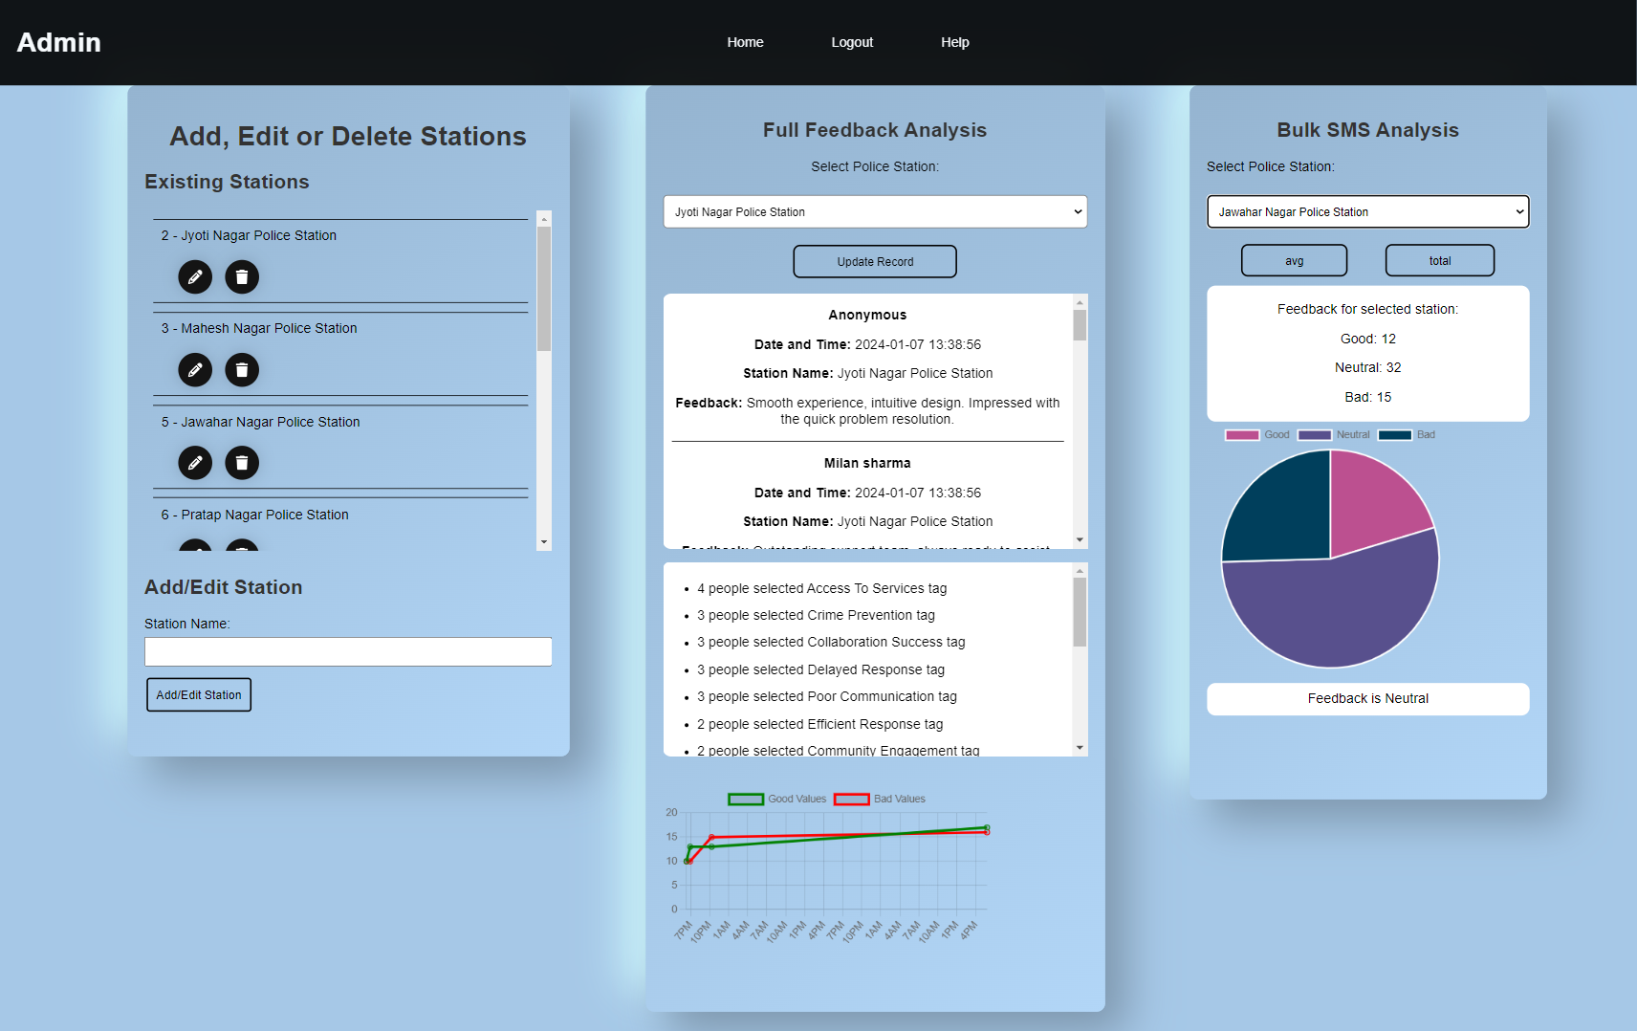
Feedback Analysis
Feedback Analysis page provides full feedback analysis as well as Bulk SMS feedback analysis.
Full feedbacks are mostly analysed using the tags, provided in the feedback.
Bulk SMS are analysed based on the feedback provided, good, neutral or bad.
Feedback analysis page also lets admin add more stations for the users to choose from.

Slide 10
Technologies
The technologies used in this project are:
Html
CSS
JavaScript
PHP
MySQL
Python

Slide 11

Thank you

